Slide 1
better 1-octene catalysts via molecular modelling
Sibo Lin*¹, Jenna C. Fromer², YagnaSENI Ghosh¹, Brian Hanna¹, Mohamed Elanany³, Wei Xu³
¹ Advanced Materials Team, Boston Research Center, Aramco Americas ² Chemical Engineering Division, Tufts University ³ Chemicals R&D Division, Saudi AramCO

Slide 2

linear α-olefins for LLDPE
polyethylene plant
LLDPE
1-butene
ethylene
1-hexene
1-butene
1-hexene
polymer quality increases
1-octene
1-octene
highest quality plastic

Slide 3
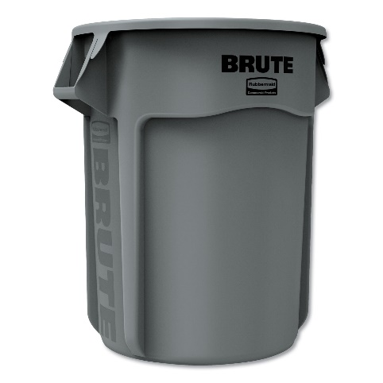
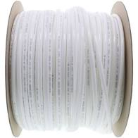
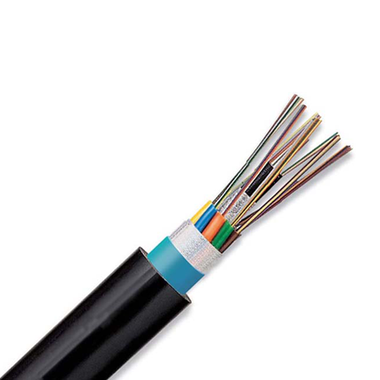
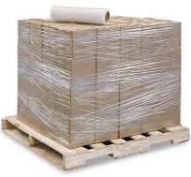
LLDPE
tough
flexible and food-safe
1-butene
stretchable
electrical and chemical safety
1-hexene
1-octene
Notes:
Image credits:
https://www.uline.com/Product/Detail/S-12827/Uline-Stretch-Wrap/Economy-Stretch-Wrap-Cast-80-gauge-18-x-1500
https://www.freshwatersystems.com/products/3-8-od-lldpe-polyethylene-tubing-500-ft-roll
https://www.hillnmarkes.com/
http://www.blspolymers.com/LLDPE.htm

Slide 4
full range α-olefins processes
How to make 1-octene selectively?
undesired products
1-butene
1-hexene
existing commercialized full range technologies:
Shell Higher Olefin Process (SHOP)
Chevron Phillips full-range process
INEOS process
1-octene
Nexant report - Developments in LAO Comonomer for Polyethylene - PERP 2012S11

Slide 5

making 1-octene selectively from ethylene
Sasol’s catalyst
Activity (kg/g Cr/h) | 1-C₈ (wt%) | 1-C₆ (wt%) | PE (wt%)
272.4 | 67 | 12 | 1
Bollman et al, J. Am. Chem. Soc. 2004, 126, 14712
Confidential

Slide 6
ligand degradation may result in polyethylene
ligand | acid adduct¹ | activity² | C8 (wt%) | C6 (wt%) | PE (wt%)
 |  | 85 | 43 | 24 | 31
 |  | 1700 | 54 | 38 | 3
¹ Product with H[BAr^{F}₄]
² Catalytic activity (g/g Cr/h) with CrCl₃(THF)₃, 300 equiv. MMAO-3A, 60 psi C₂H₄
Agapie and coworkers, Organometallics, 2017, 36, 1640

Slide 7
hypotheses
computational modelling can predict PNP ligand stability
PNP instability is correlated with PE formation

Slide 8
computational prediction of isomerization thermochemistry (ΔG_{PPN})
2
2
3
2
3
2
3
wrong ΔG
how many conformers?
right ΔG
ca. 3³ x 2⁴ = 432
too many to rely on human intuition or employ brute-force high-level simulations

Slide 9
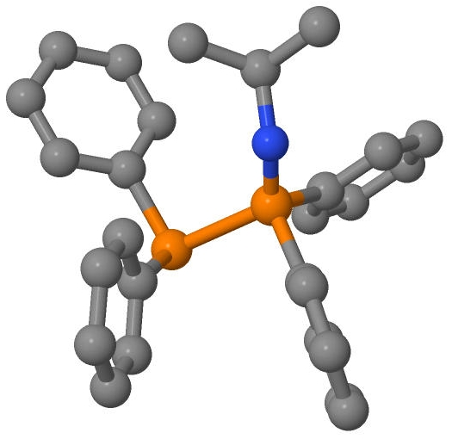
XTBDFT
conformer ensemble generation and ranking
(CREST and GFN-xTB)
ensemble refinement (NWChem)
minimum final optimization (NWChem)
quasi-harmonic frequency corrections
(Goodvibes)
62 conformers within 6 kcal/mol window
final structure and energy*
input geometry
(PES is only illustrative)
*calculated with B3LYP-D3/def2-TZVP//B3LYP-D3/def2-SVP and quasi-harmonic frequency corrections

Slide 10
ΔG_{PPN} vs known PNP/PPN ligands
ΔG_{PPN} > 0 (PNP favored)
ΔG_{PPN} < 0 (PPN favored)
If |ΔG_{PPN}| > 0.9 kcal/mol, prediction matches observations for 30+ known PNP/PPN

Slide 11
catalyst performance vs ΔG_{PPN}
✓
✓
make more stable (better) PNP catalysts
S. Kuhlmann, K. Blann, et al., J. Catal., 2007, 245, 279-284
K. Blann, A. Bollmann, et al., J. Catal., 2007, 249, 244-249.
E. Killian, K. Blann, et al., J. Mol. Catal. A: Chem., 2007, 270, 214-218.
Notes:
S. Kuhlmann, K. Blann, A. Bollmann, J. T. Dixon, E. Killian, M. C. Maumela, H. Maumela, D. H. Morgan, M. Prétorius, N. Taccardi and P. Wasserscheid, J. Catal., 2007, 245, 279-284.
K. Blann, A. Bollmann, H. de Bod, J. T. Dixon, E. Killian, P. Nongodlwana, M. C. Maumela, H. Maumela, A. E. McConnell, D. H. Morgan, M. J. Overett, M. Prétorius, et al., J. Catal., 2007, 249, 244-249.
E. Killian, K. Blann, A. Bollmann, J. T. Dixon, S. Kuhlmann, M. C. Maumela, H. Maumela, D. H. Morgan, P. Nongodlwana, M. J. Overett, M. Pretorius, K. Höfener, et al., J. Mol. Catal. A: Chem., 2007, 270, 214-218.

Slide 12
design criteria to maximize PNP stability (and lower PE fouling)
electron-rich N-substituents
N-alkyl over N-aryl
R | ΔG_{PPN}
OMe | 4.7
H | 3.5
NO₂ | -0.9
ΔG_{PPN} | 3.5 | 9.0 | 0.5 | 8.9
N-alkyl: 2˚ > 1˚ >> 3˚
electron-poor P-substituents
R | ΔG_{PPN}
CH₂Ph | 8.6
CHMe₂ | 9.5
CMe₃ | 2.5
R | ΔG_{PPN}
CF₃ | 11.6
H | 9.5
OMe | -0.1
ΔG_{PPN} in kcal/mol

Slide 13
ligand candidates screened out (ΔG_{PPN} < 1 kcal/mol)
ΔG_{PPN} > 0 (PNP favored)
ΔG_{PPN} < 0 (PPN favored)

Slide 14
summary
supported hypotheses
established PNP design criteria
ΔG_{PPN} > 1 kcal/mol
2˚ alkyl N-substituent
electron-poor P-substituents
ruled out several candidates

Slide 15
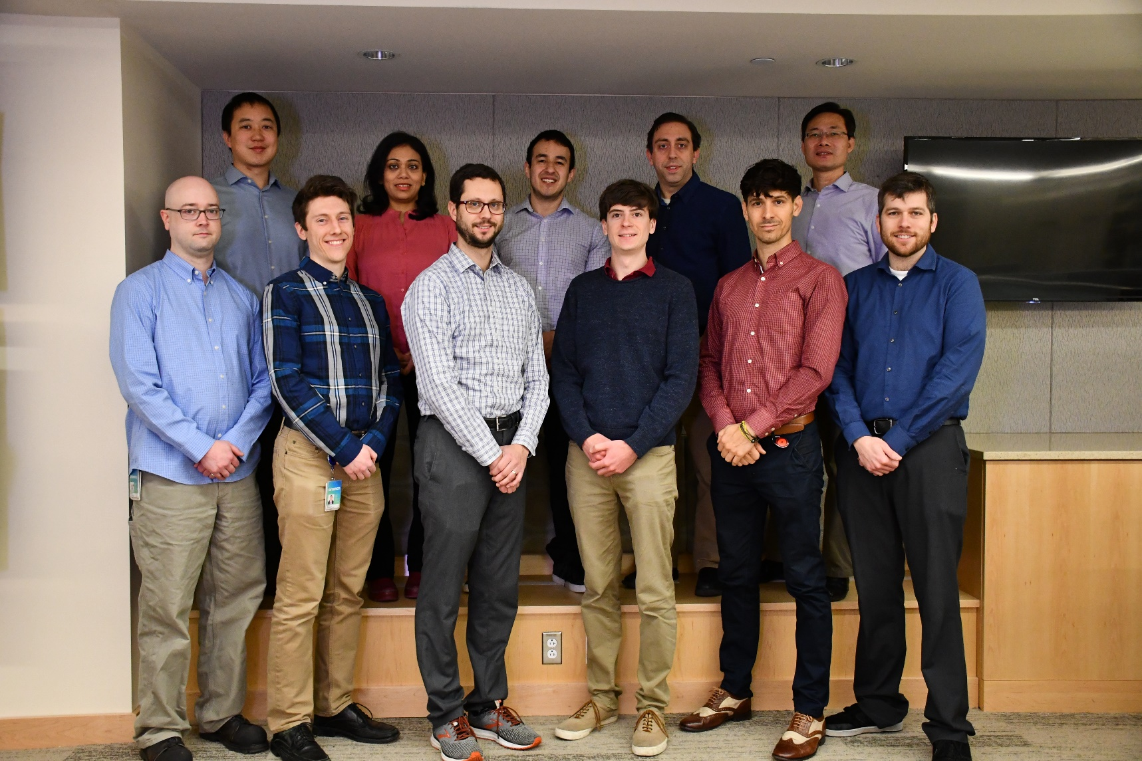
acknowledgements
advanced materials team, aramco americas – Cambridge,MA
Jenna C. Fromer*
Yagnaseni Ghosh*
Brian Hanna*
Timothy Kucharski
Douglas Theberge
Dana Wong
saudi aramco chemicals R&D
Mohamed Elanany*
Wei Xu*

Slide 16
thank you

Slide 17
supplementary slides…

Slide 18
1-octene results from metallocycle mechanism

Slide 19
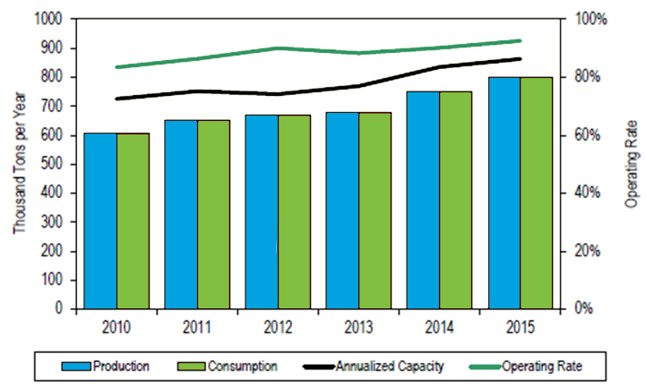
need for selective ethylene tetramerization
production capacity of 1-octene is not projected to keep pace with demand
1-butene
1-hexene
1-octene
Nexant report - Developments in LAO Comonomer for Polyethylene - PERP 2012S11
Confidential

Slide 20
GFN-xTB/CREST vs molecular mechanics (MM)
Computational intensity: MM < GFN-xTB << DFT
MM methods must be carefully parameterized for molecules of interest
Commonly available MM methods (MMFF and UFF) perform poorly with metal centers or exotic functional groups
GFN-xTB is generally applicable to many elements (H-Rn) and types of molecules[ref]
CREST uses meta-dynamics to explore wide conformer space
CREST also eliminates symmetrically equivalent conformers (by comparing energy and symmetry)

Slide 21

need well-designed catalysts to avoid polymerization
polymerization catalyst
tetramerization catalyst

